Slide 1


Slide 2


Slide 3


Slide 4


Slide 5


Slide 6


Slide 7


Slide 8
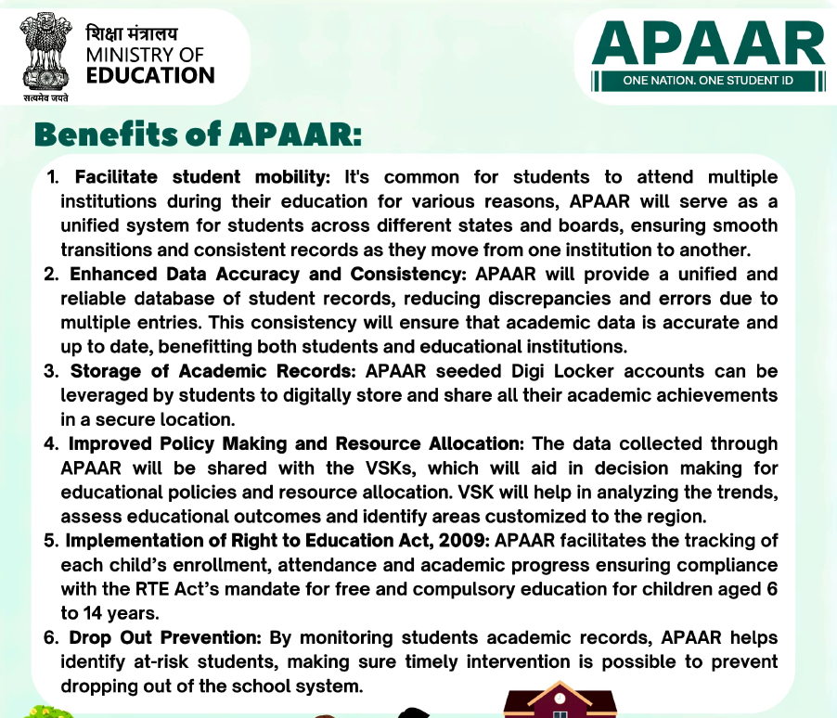

Slide 9


Slide 10


Slide 11


Slide 12
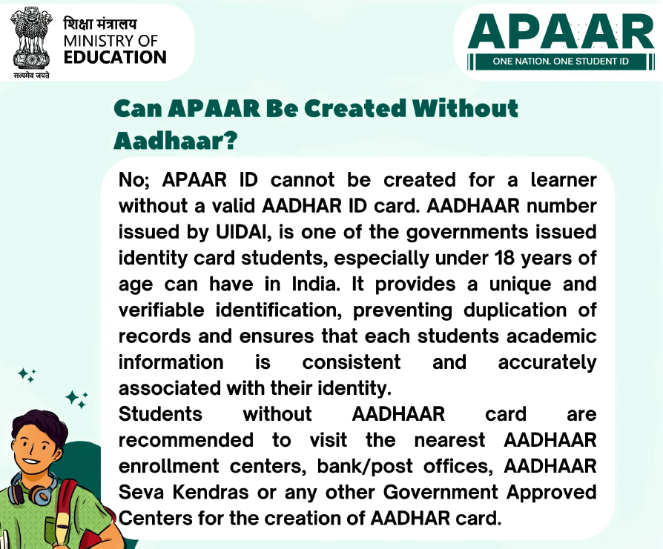

Slide 13


Slide 14
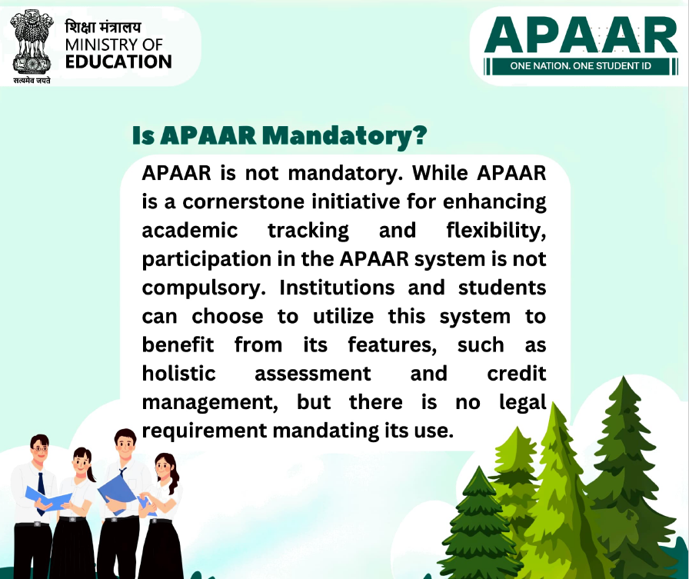

Slide 15
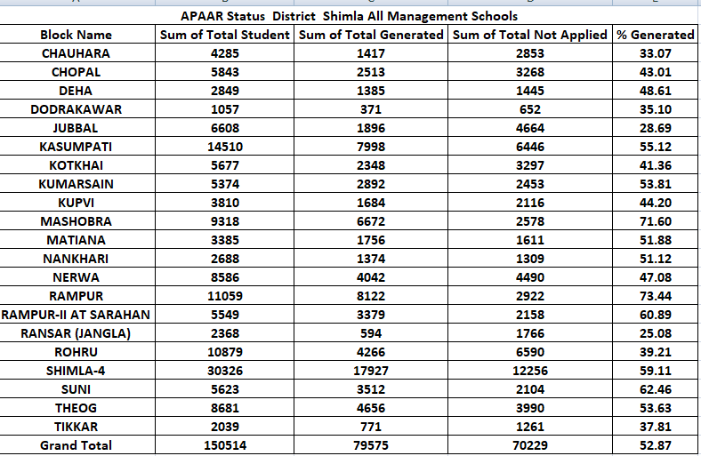

Slide 16
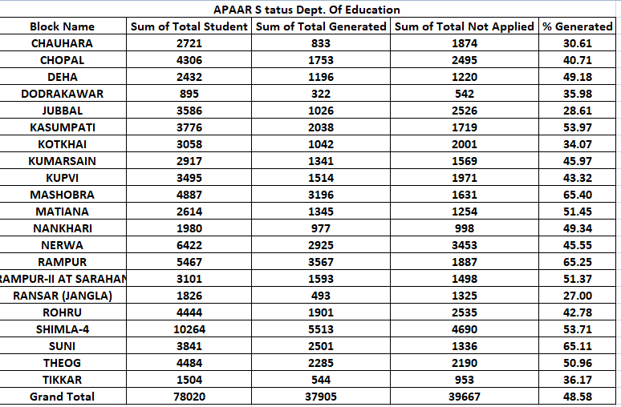

Slide 17
APAAR Status Pvt. Schools
Block Name | Sum of Total Student | Sum of Total Generated | Sum of Total Not Applied | % Generated
CHAUHARA | 1564 | 584 | 979 | 37.34
CHOPAL | 1537 | 760 | 773 | 49.45
DEHA | 417 | 189 | 225 | 45.32
DODRAKAWAR | 162 | 49 | 110 | 30.25
JUBBAL | 3022 | 870 | 2138 | 28.79
KASUMPATI | 10734 | 5960 | 4727 | 55.52
KOTKHAI | 2619 | 1306 | 1296 | 49.87
KUMARSAIN | 2457 | 1551 | 884 | 63.13
KUPVI | 315 | 170 | 145 | 53.97
MASHOBRA | 4431 | 3476 | 947 | 78.45
MATIANA | 771 | 411 | 357 | 53.31
NANKHARI | 708 | 397 | 311 | 56.07
NERWA | 2164 | 1117 | 1037 | 51.62
RAMPUR | 5592 | 4555 | 1035 | 81.46
RAMPUR-II AT SARAHAN | 2448 | 1786 | 660 | 72.96
RANSAR (JANGLA) | 542 | 101 | 441 | 18.63
ROHRU | 6435 | 2365 | 4055 | 36.75
SHIMLA-4 | 20062 | 12414 | 7566 | 61.88
SUNI | 1782 | 1011 | 768 | 56.73
THEOG | 4197 | 2371 | 1800 | 56.49
TIKKAR | 535 | 227 | 308 | 42.43
Grand Total | 72494 | 41670 | 30562 | 57.48

Slide 18
Department of education Schools 2025
Block_Name_&_Code | Primary | Middle | Sr. Sec Schools | High schools | Grand Total
CHAUHARA_&_021101 | 58 | 4 | 12 | 6 | 80
CHOPAL_&_021102 | 77 | 12 | 17 | 7 | 113
DEHA_&_021103 | 51 | 6 | 13 | 6 | 76
DODRAKAWAR_&_021104 | 12 | 4 | 3 | 1 | 20
JUBBAL_&_021105 | 77 | 14 | 20 | 3 | 114
KASUMPATI_&_021106 | 63 | 10 | 10 | 6 | 89
KOTKHAI_&_021107 | 87 | 8 | 18 | 7 | 120
KUMARSAIN_&_021108 | 70 | 16 | 14 | 4 | 104
KUPVI_&_021118 | 58 | 10 | 10 | 3 | 81
MASHOBRA_&_021109 | 76 | 11 | 17 | 7 | 111
MATIANA_&_021110 | 49 | 7 | 11 | 3 | 70
NANKHARI_&_021111 | 58 | 10 | 12 | 4 | 84
NERWA_&_021112 | 108 | 13 | 24 | 7 | 152
RAMPUR_&_021113 | 81 | 9 | 14 | 9 | 113
RAMPUR-II AT SARAHAN_&_021119 | 68 | 12 | 11 | 6 | 97
RANSAR (JANGLA)_&_021121 | 44 | 6 | 6 | 4 | 60
ROHRU_&_021114 | 79 | 15 | 15 | 8 | 117
SHIMLA-4_&_021115 | 86 | 21 | 19 | 10 | 136
SUNI_&_021116 | 83 | 17 | 19 | 6 | 125
THEOG_&_021117 | 73 | 11 | 14 | 7 | 105
TIKKAR_&_021120 | 38 | 3 | 9 | 5 | 55
Grand Total | 1396 | 219 | 288 | 119 | 2022

Slide 19
Pvt. Schools 2025
Block_Name_&_Code | Primary | Pry with Upper Pry | Pry with Up& Sec. &h. Sec. | Pry with Up and Sec. | Grand Total
CHAUHARA_&_021101 | 1 | 2 | 1 | 4 | 8
CHOPAL_&_021102 | 5 | 3 | 1 | 6 | 15
DEHA_&_021103 |  | 1 |  | 4 | 5
DODRAKAWAR_&_021104 | 2 |  |  |  | 2
JUBBAL_&_021105 | 1 | 3 | 1 | 8 | 13
KASUMPATI_&_021106 | 3 | 7 | 13 | 5 | 28
KOTKHAI_&_021107 | 4 | 5 | 4 | 2 | 15
KUMARSAIN_&_021108 | 3 | 7 | 4 | 6 | 20
KUPVI_&_021118 | 1 | 2 |  | 1 | 4
MASHOBRA_&_021109 | 3 | 4 | 6 | 9 | 22
MATIANA_&_021110 | 2 | 3 | 2 | 1 | 8
NANKHARI_&_021111 |  | 6 |  | 4 | 10
NERWA_&_021112 | 6 | 3 | 1 | 5 | 15
RAMPUR_&_021113 | 2 | 9 | 6 | 6 | 23
RAMPUR-II AT SARAHAN_&_021119 | 1 | 3 | 3 | 5 | 12
RANSAR (JANGLA)_&_021121 |  | 3 |  | 2 | 5
ROHRU_&_021114 | 4 | 9 | 4 | 9 | 26
SHIMLA-4_&_021115 | 7 | 9 | 23 | 10 | 49
SUNI_&_021116 | 6 | 5 | 4 | 2 | 17
THEOG_&_021117 | 3 | 3 | 6 | 6 | 18
TIKKAR_&_021120 | 2 | 4 |  | 1 | 7
Grand Total | 56 | 91 | 79 | 96 | 322

Slide 20
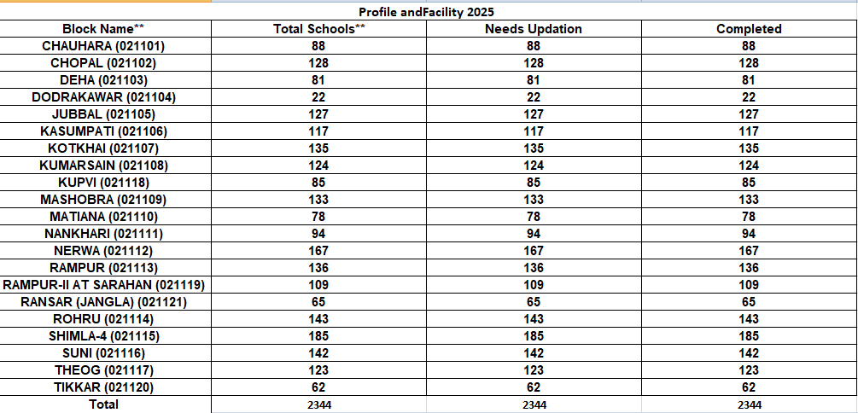

Slide 21
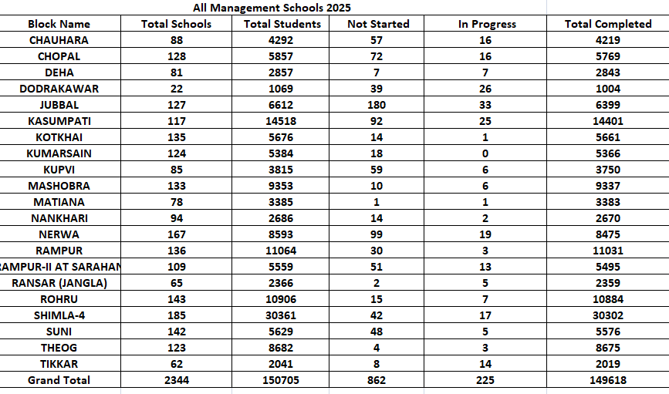

Slide 22
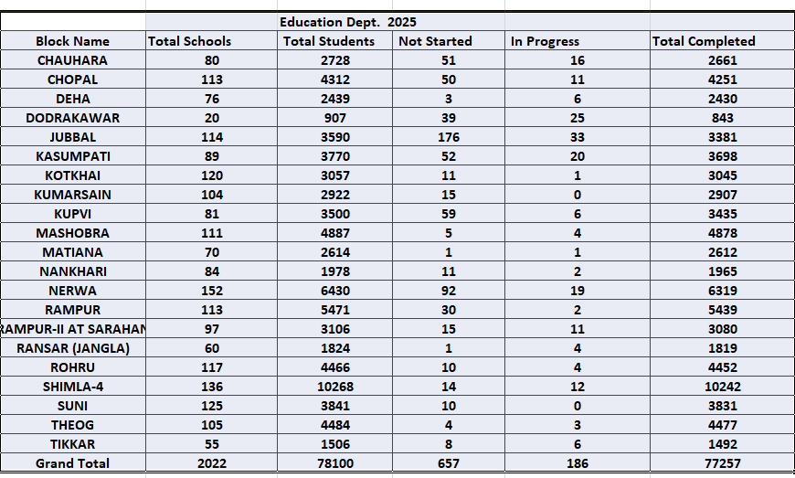

Slide 23
